Slide 1

CS 224S / LINGUIST 285 Spoken Language Processing
Andrew Maas
Stanford University
Spring 2017
Lecture 10: Dialogue System Introduction and Frame-Based Dialogue
Original slides by Dan Jurafsky

Slide 2
Dialog section
May 3: Dialog introduction. Frame based systems
May 8: Human conversation. Reinforcement learning for dialog
May 10: Deep learning for dialog (Jiwei)
May 31: Dialog in industry (Alex Lebrun, Founder of Wit.ai and Facebook M)

Slide 3
Outline
Basic Conversational Agents
ASR
NLU
Generation
Dialogue Manager
Dialogue Manager Design
Finite State
Frame-based
Dialogue Design Considerations

Slide 4
Conversational Agents
AKA:
Spoken Language Systems
Dialogue Systems
Speech Dialogue Systems
Applications:
Travel arrangements (Amtrak, United airlines)
Telephone call routing
Tutoring
Communicating with robots
Anything with limited screen/keyboard

Slide 5
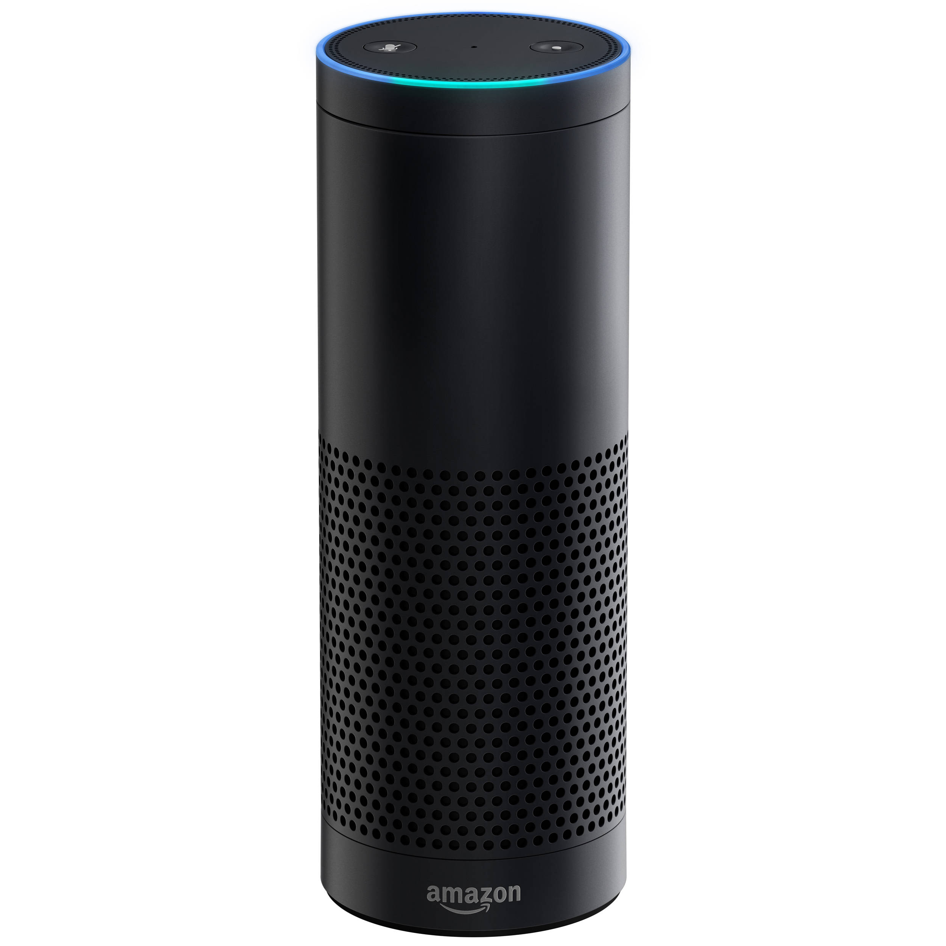
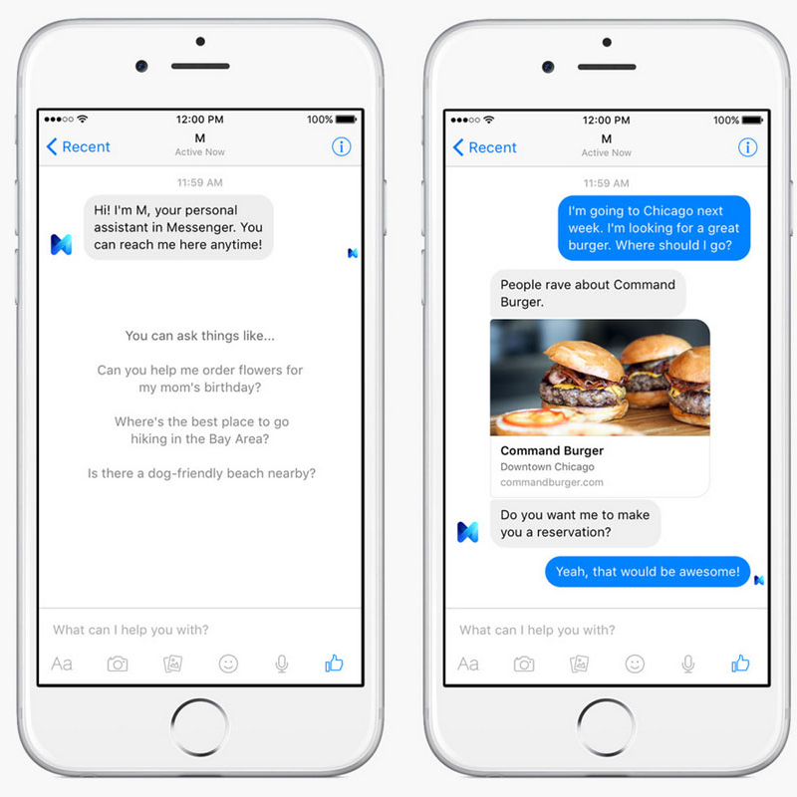

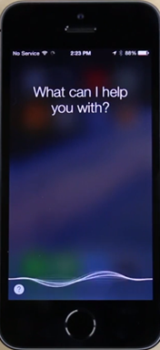
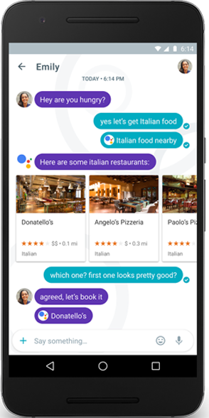
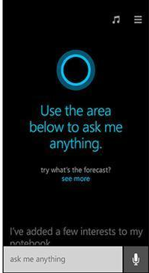
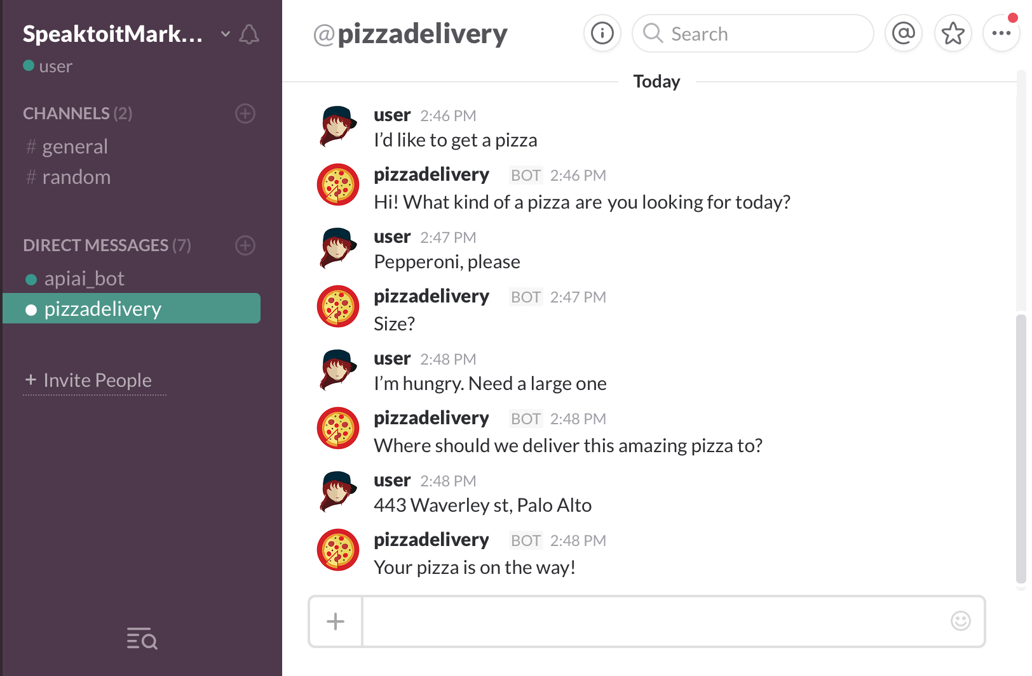
Conversational systems
Amazon Echo
2015
Google Home
2016
Facebook M
2015
Apple
Siri
2011
Google
Assistant
2016
Microsoft Cortana
2014
Slack Bot
2015

Slide 6
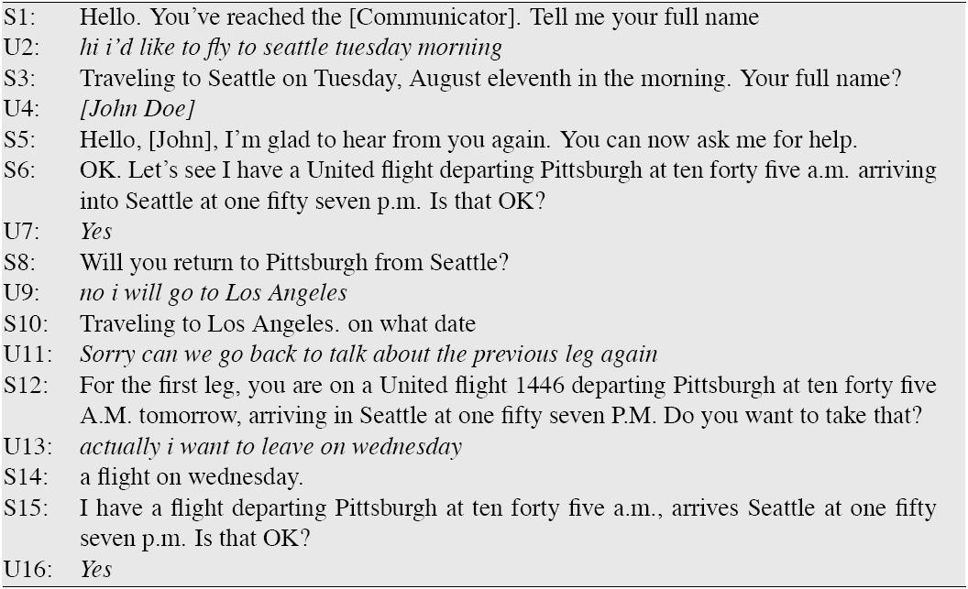
A travel dialog: Communicator Xu and Rudnicky (2000)

Slide 7
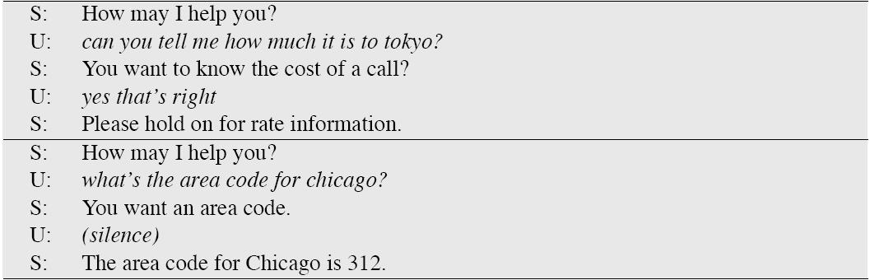
Call routing: ATT HMIHY Goren et al. (1997)

Slide 8
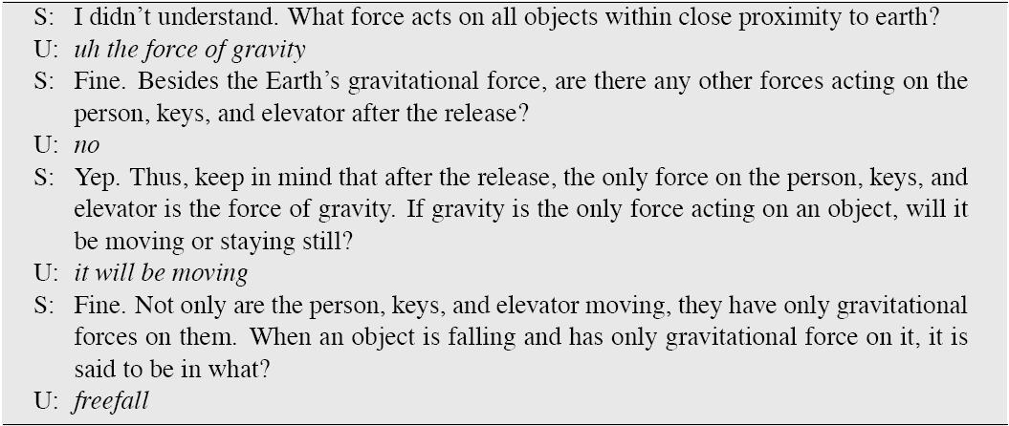
A tutorial dialogue: ITSPOKE Litman and Silliman (2004)

Slide 9
Conversational Agent Design Issues
Time to response (Synchronous?)
Task complexity
What time is it?
Book me a flight and hotel for vacation in Greece
Interaction complexity / number of turns
Single command/response
“I want new shoes” What kind? What color? What size?
Initiative
User, System, Mixed
Interaction modality
Purely spoken, Purely text, Mixing speech/text/media

Slide 10
Spoken Synchronous Personal Assistants
Siri
Google Now
Microsoft Cortana
Amazon Alexa

Slide 11
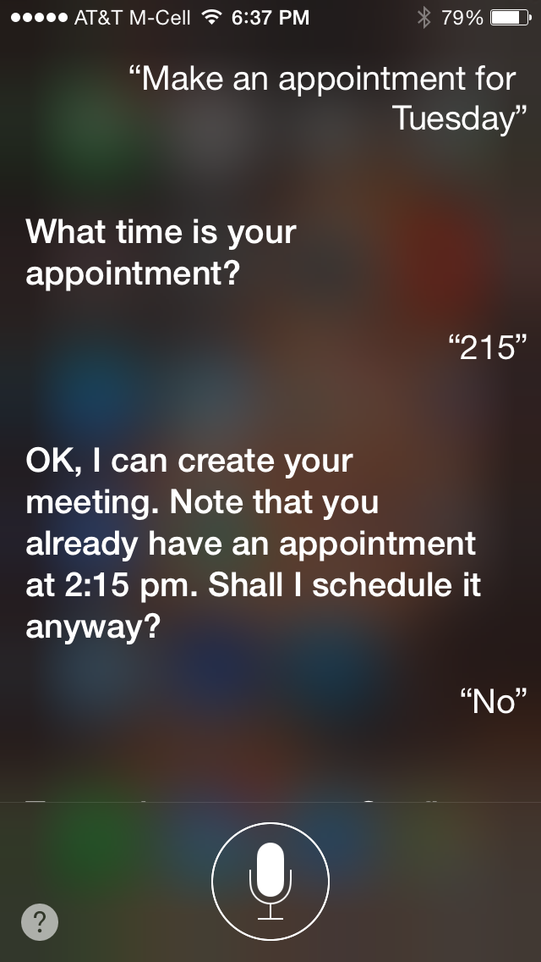
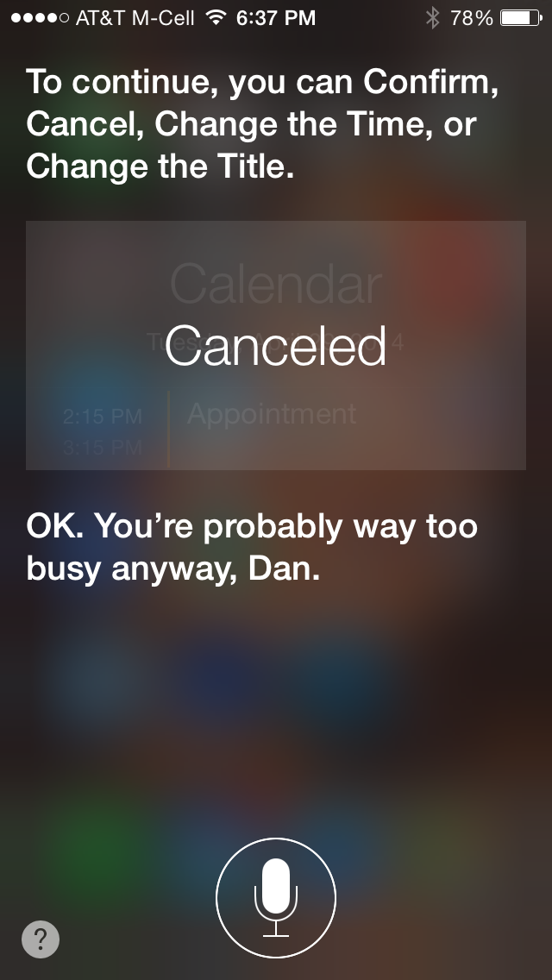
a

Slide 12
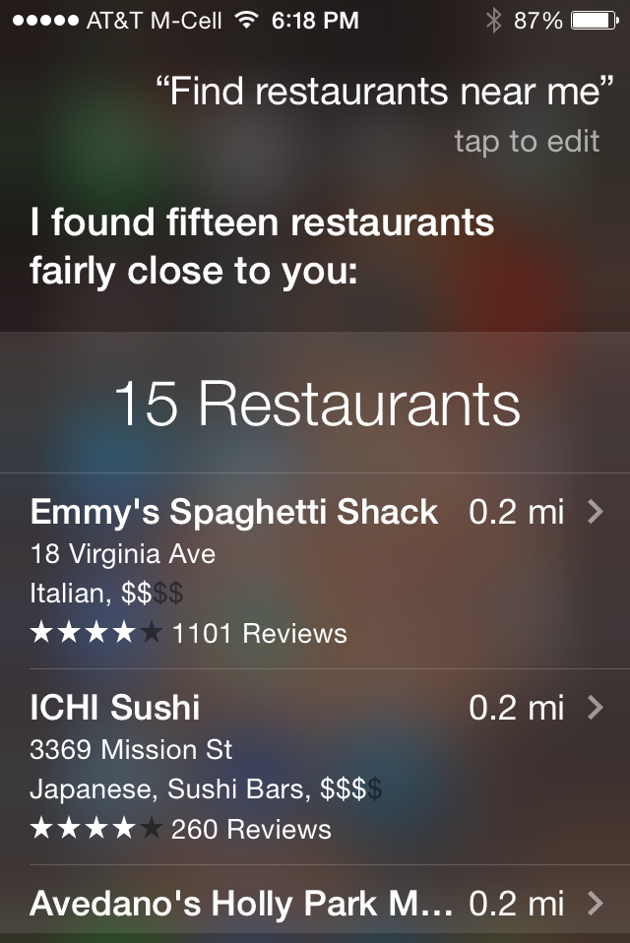
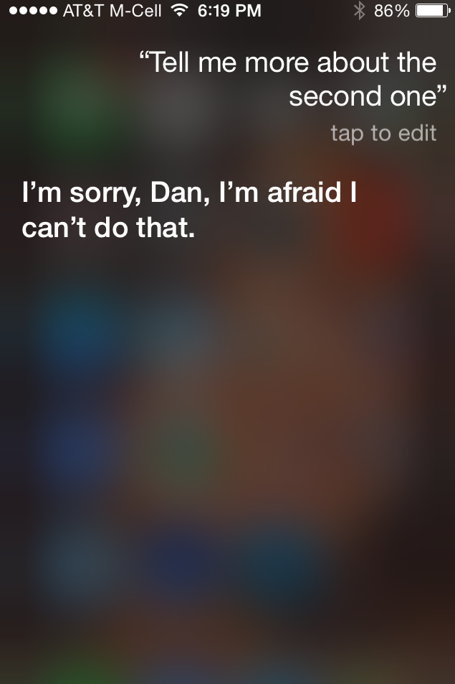

Slide 13
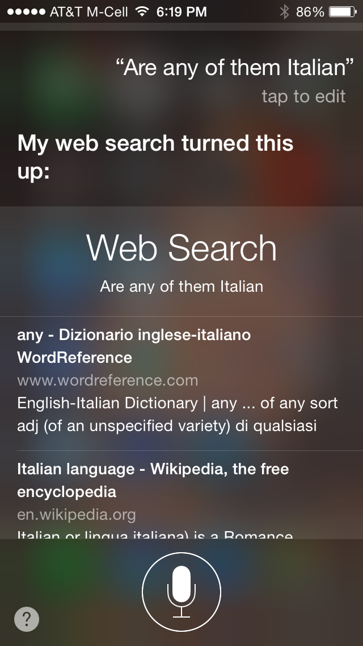

Slide 14
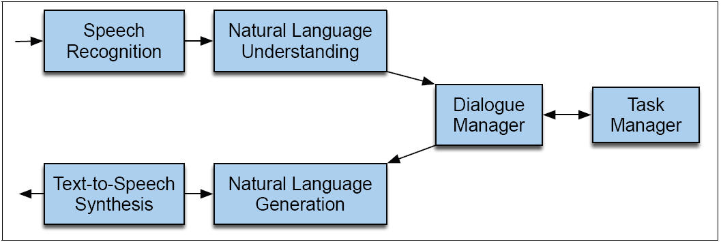
Dialogue System Architecture

Slide 15
Dialog architecture for Personal Assistants
Bellegarda

Slide 16
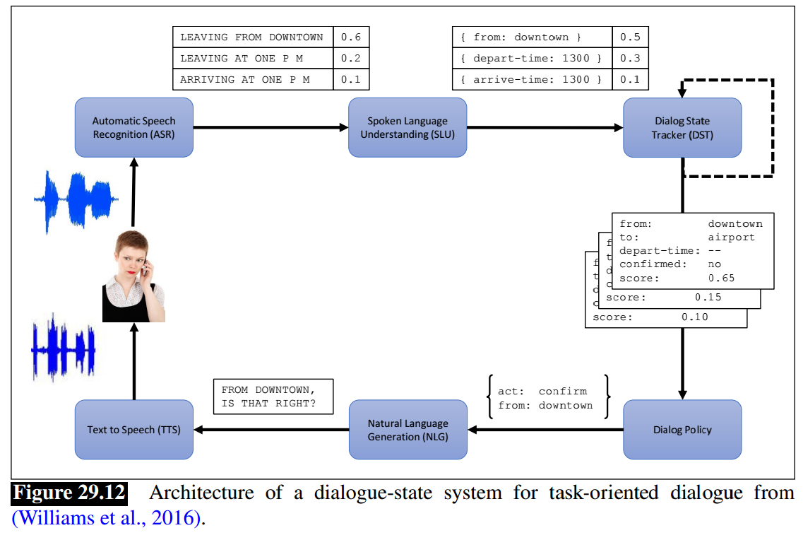
Dialog architecture for Personal Assistants

Slide 17
Dialogue Manager
Controls the architecture and structure of dialogue
Takes input from ASR/NLU components
Maintains some sort of state
Interfaces with Task Manager
Passes output to NLG/TTS modules

Slide 18
Possible architectures for dialog management
Finite State
Frame-based
Information State (Markov Decision Process)
Classic AI Planning
Distributional / neural network

Slide 19
Finite-State Dialog Management
Consider a trivial airline travel system:
Ask the user for a departure city
Ask for a destination city
Ask for a time
Ask whether the trip is round-trip or not

Slide 20
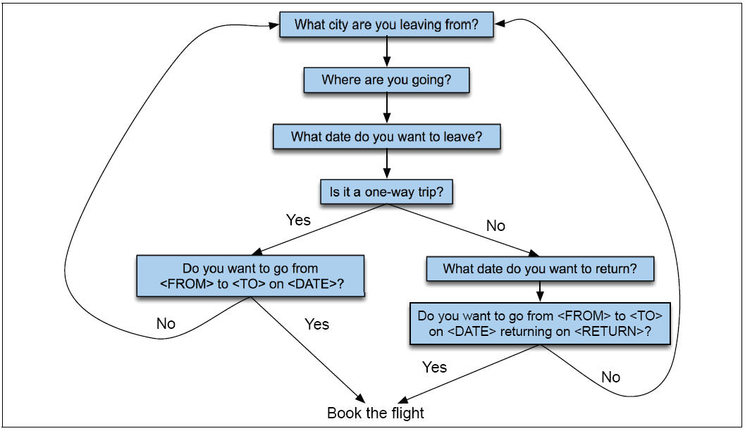
Finite State Dialog Manager

Slide 21
Finite-state dialog managers
System completely controls the conversation with the user.
It asks the user a series of questions
Ignoring (or misinterpreting) anything the user says that is not a direct answer to the system’s questions

Slide 22
Dialogue Initiative
Systems that control conversation like this are system initiative or single initiative.
Initiative: who has control of conversation
In normal human-human dialogue, initiative shifts back and forth between participants.

Slide 23
System Initiative
System completely controls the conversation
Simple to build
User always knows what they can say next
System always knows what user can say next
Known words: Better performance from ASR
Known topic: Better performance from NLU
OK for VERY simple tasks (entering a credit card, or login name and password)
Too limited
+
-

Slide 24
Problems with System Initiative
Real dialogue involves give and take!
In travel planning, users might want to say something that is not the direct answer to the question.
For example answering more than one question in a sentence:
Hi, I’d like to fly from Seattle Tuesday morning
I want a flight from Milwaukee to Orlando one way leaving after 5 p.m. on Wednesday.

Slide 25
Single initiative + universals
We can give users a little more flexibility by adding universals: commands you can say anywhere
As if we augmented every state of FSA with these
Help
Start over
Correct
This describes many implemented systems
But still doesn’t allow user much flexibility

Slide 26
User Initiative
User directs the system
Asks a single question, system answers
Examples: Voice web search
But system can’t:
ask questions back,
engage in clarification dialogue,
engage in confirmation dialogue

Slide 27
Mixed Initiative
Conversational initiative can shift between system and user
Simplest kind of mixed initiative: use the structure of the frame to guide dialogue

Slide 28
An example of a frame
FLIGHT FRAME:
ORIGIN:
CITY: Boston
DATE: Tuesday
TIME: morning
DEST:
CITY: San Francisco
AIRLINE:
…

Slide 29
Mixed Initiative
Conversational initiative can shift between system and user
Simplest kind of mixed initiative: use the structure of the frame to guide dialogue
Slot Question
ORIGIN What city are you leaving from?
DEST Where are you going?
DEPT DATE What day would you like to leave?
DEPT TIME What time would you like to leave?
AIRLINE What is your preferred airline?

Slide 30
Frames are mixed-initiative
User can answer multiple questions at once.
System asks questions of user, filling any slots that user specifies
When frame is filled, do database query
If user answers 3 questions at once, system has to fill slots and not ask these questions again!
Avoids strict constraints on order of the finite-state architecture.

Slide 31
Multiple frames
flights, hotels, rental cars
Flight legs: Each flight can have multiple legs, which might need to be discussed separately
Presenting the flights (If there are multiple flights meeting users constraints)
It has slots like 1ST_FLIGHT or 2ND_FLIGHT so user can ask “how much is the second one”
General route information:
Which airlines fly from Boston to San Francisco
Airfare practices:
Do I have to stay over Saturday to get a decent airfare?

Slide 32
Natural Language Understanding
There are many ways to represent the meaning of sentences
For speech dialogue systems, most common is “Frame and slot semantics”.

Slide 33
An example of a frame
Show me morning flights from Boston to SF on Tuesday.
SHOW:
FLIGHTS:
ORIGIN:
CITY: Boston
DATE: Tuesday
TIME: morning
DEST:
CITY: San Francisco

Slide 34
Semantics for a sentence
LIST FLIGHTS ORIGIN
Show me flights from Boston
DESTINATION DEPARTDATE
to San Francisco on Tuesday
DEPARTTIME
morning

Slide 35
Idea: HMMs for semantics
Hidden units are slot names
ORIGIN
DESTCITY
DEPARTTIME
Observations are word sequences
on Tuesday

Slide 36
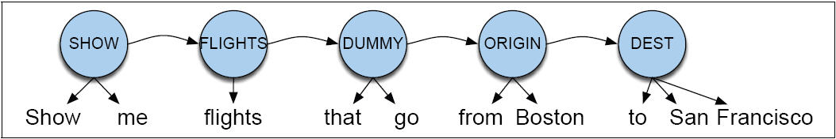
HMM model of semantics
Pieraccini et al (1991)

Slide 37
Semantic HMM
Goal of HMM model:
To compute labeling of semantic roles C = c1,c2,…,cn
(C for ‘cases’ or ‘concepts’)
that is most probable given words W

Slide 38
Semantic HMM
From previous slide:
Assume simplification:
Final form:

Slide 39
semi-HMM model of semantics
Pieraccini et al (1991)
P(W|C) =
P(me|show,SHOW) P(show|SHOW) P(flights|FLIGHTS)…
P(FLIGHTS|SHOW) P(DUMMY|FLIGHTS)…

Slide 40
Semi-HMMs
Each hidden state
Can generate multiple observations
By contrast, a traditional HMM
One observation per hidden state
Need to loop to have multiple observations with the same state label

Slide 41
How to train
Supervised training
Label and segment each sentence with frame fillers
Essentially learning an N-gram grammar for each slot
LIST FLIGHTS DUMMY ORIGIN DEST
Show me flights that go from Boston to SF

Slide 42
Another way to do NLU: Semantic Grammars
CFG in which the LHS of rules is a semantic category:
LIST -> show me | I want | can I see|…
DEPARTTIME -> (after|around|before) HOUR | morning | afternoon | evening
HOUR -> one|two|three…|twelve (am|pm)
FLIGHTS -> (a) flight|flights
ORIGIN -> from CITY
DESTINATION -> to CITY
CITY -> Boston | San Francisco | Denver | Washington

Slide 43
Tina parse tree with semantic rules
Seneff 1992

Slide 44
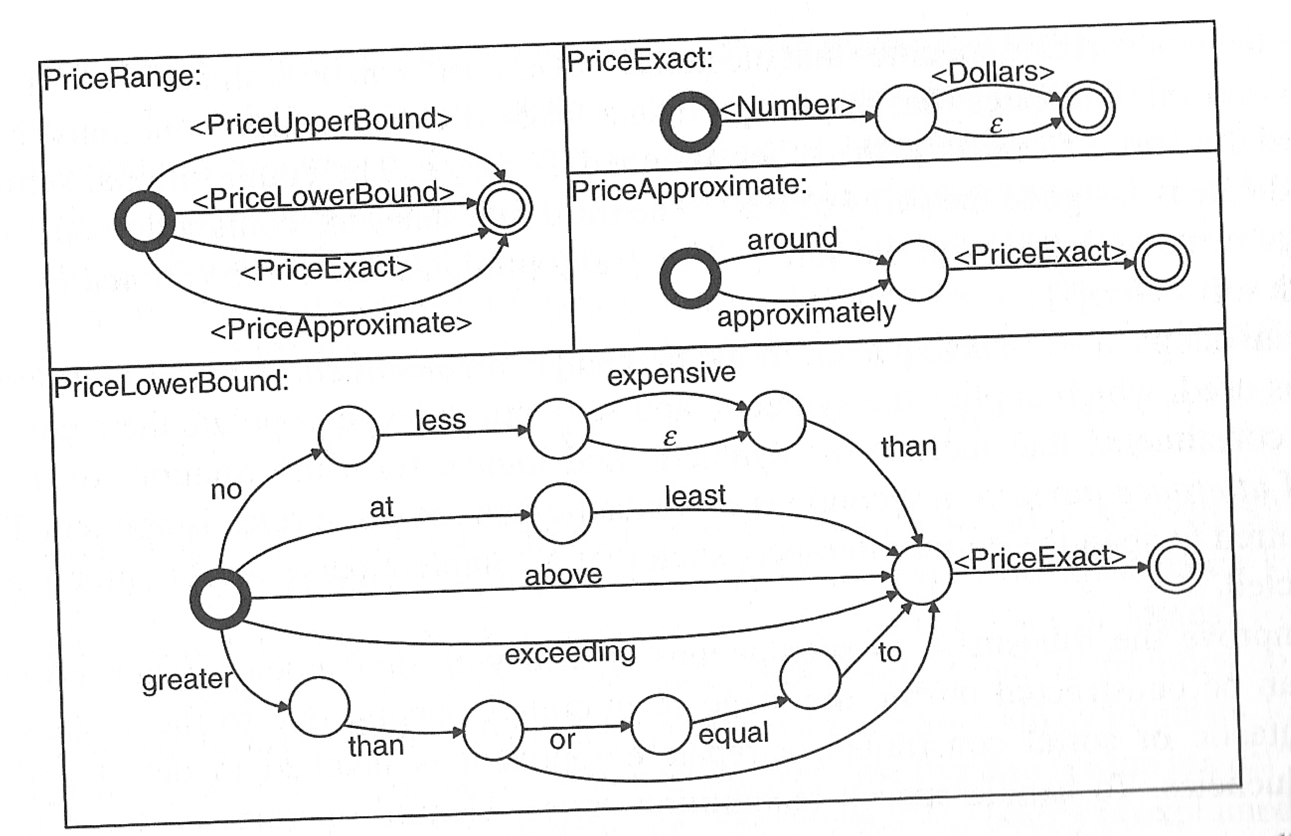
Phoenix SLU system: Recursive Transition Network
Ward 1991, figure from Wang, Deng, Acero

Slide 45
Modern Approach: Semantic Parsing
System translates natural language into logical forms
System can act on structured logical forms
Modern approaches mix hand engineered grammar generation with machine learning to map input text to output structured form

Slide 46
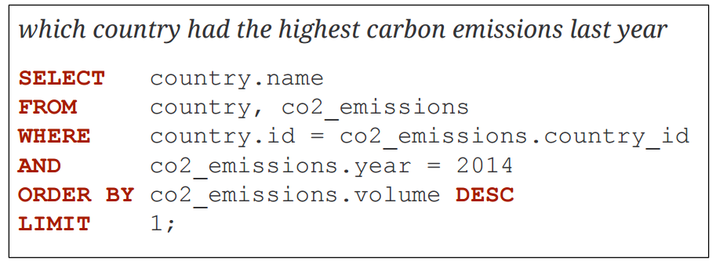
Semantic Parsing Output: Database Query
Directly map natural language to database queries
Potentially time consuming to build/train for a new schema, but a clean, clear formalism
Slide from Bill McCartney CS224U

Slide 47
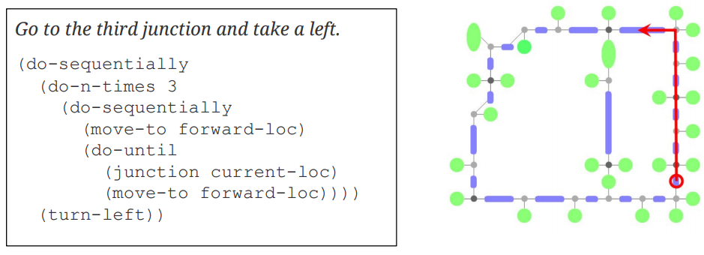
Semantic Parsing Output: Procedural Languages
Express concept, nested states or action sequences
Designing set of possible actions and composition rules can get very complex
How much can a user reasonably specify in one utterance?
Slide from Bill McCartney CS224U

Slide 48
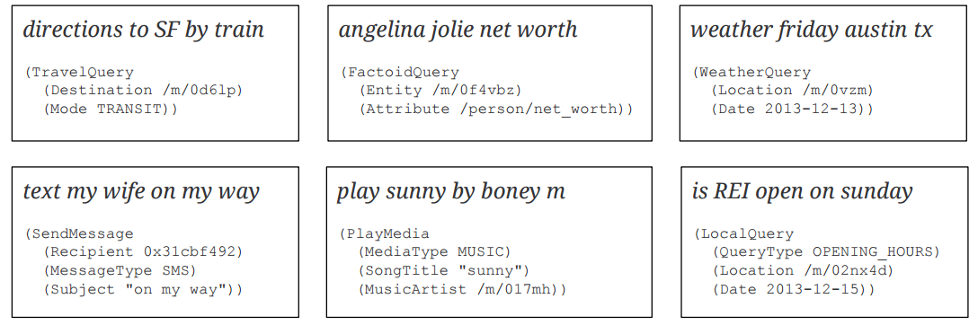
Semantic Parsing Output: Intents and Arguments
Personal assistant voice commands are simple and need to scale to many domains
Simplicity helps with robustness and scale, just recognize what action and what required arguments for that action
Slide from Bill McCartney CS224U

Slide 49
Semantic Parsing Approach Outline
Very active area of research
Define possible syntactic structures using a context-free grammar
Construct semantics bottom-up, following syntactic structure
Score parses with a (log-linear) model that was fit on training input, action/output pairs
Use external annotators to recognize names, dates, places, etc.
Grammar induction if possible, or lots of grammar engineering
Slide from Bill McCartney CS224U

Slide 50
A final way to do NLU: Condition-Action Rules
Active Ontology: relational network of concepts
data structures: a meeting has
a date and time,
a location,
a topic
a list of attendees
rule sets that perform actions for concepts
the date concept turns string
Monday at 2pm into
date object date(DAY,MONTH,YEAR,HOURS,MINUTES)

Slide 51
Rule sets
Collections of rules consisting of:
condition
action
When user input is processed, facts added to store and
rule conditions are evaluated
relevant actions executed

Slide 52
Part of ontology for meeting task
has-a
may-have-a
meeting concept: if you don’t yet have a location, ask for a location

Slide 53
Other components

Slide 54
ASR: Language Models for dialogue
Often based on hand-written Context-Free or finite-state grammars rather than N-grams
Why?
Need for understanding; we need to constrain user to say things that we know what to do with.

Slide 55
ASR: Language Models for Dialogue
We can have LM specific to a dialogue state
If system just asked “What city are you departing from?”
LM can be
City names only
FSA: (I want to (leave|depart)) (from) [CITYNAME]
N-grams trained on answers to “Cityname” questions from labeled data
A LM that is constrained in this way is technically called a “restricted grammar” or “restricted LM”

Slide 56
Generation Component
Content Planner
Decides what content to express to user
(ask a question, present an answer, etc)
Often merged with dialogue manager
Language Generation
Chooses syntax and words
TTS
In practice: Template-based w/most words prespecified
What time do you want to leave CITY-ORIG?
Will you return to CITY-ORIG from CITY-DEST?

Slide 57
More sophisticated language generation component
Natural Language Generation
Approach:
Dialogue manager builds representation of meaning of utterance to be expressed
Passes this to a “generator”
Generators have three components
Sentence planner
Surface realizer
Prosody assigner

Slide 58
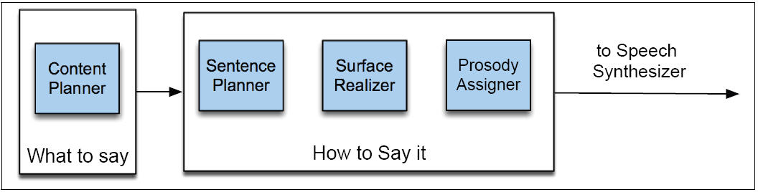
Architecture of a generator for a dialogue system
Walker and Rambow 2002)

Slide 59
HCI constraints on generation for dialogue: “Coherence”
Discourse markers and pronouns (“Coherence”):
Please say the date.
…
Please say the start time.
…
Please say the duration…
…
Please say the subject…
First, tell me the date.
…
Next, I’ll need the time it starts.
…
Thanks. <pause> Now, how long is it supposed to last?
…
Last of all, I just need a brief description
Bad!
Good!

Slide 60
HCI constraints on generation for dialogue: coherence (II): tapered prompts
Prompts which get incrementally shorter:
System: Now, what’s the first company to add to your watch list?
Caller: Cisco
System: What’s the next company name? (Or, you can say, “Finished”)
Caller: IBM
System: Tell me the next company name, or say, “Finished.”
Caller: Intel
System: Next one?
Caller: America Online.
System: Next?
Caller: …

Slide 61
How mixed initiative is usually defined
First we need to define two other factors
Open prompts vs. directive prompts
Restrictive versus non-restrictive grammar

Slide 62
Open vs. Directive Prompts
Open prompt
System gives user very few constraints
User can respond how they please:
“How may I help you?” “How may I direct your call?”
Directive prompt
Explicit instructs user how to respond
“Say yes if you accept the call; otherwise, say no”

Slide 63
Restrictive vs. Non-restrictive grammars
Restrictive grammar
Language model which strongly constrains the ASR system, based on dialogue state
Non-restrictive grammar
Open language model which is not restricted to a particular dialogue state

Slide 64
Definition of Mixed Initiative
Grammar | Open Prompt | Directive Prompt
Restrictive | Doesn’t make sense | System Initiative
Non-restrictive | User Initiative | Mixed Initiative

Slide 65
Evaluation
Slot Error Rate for a Sentence
# of inserted/deleted/subsituted slots
# of total reference slots for sentence
End-to-end evaluation (Task Success)

Slide 66
Evaluation Metrics
“Make an appointment with Chris at 10:30 in Gates 104”
Slot | Filler
PERSON | Chris
TIME | 11:30 a.m.
ROOM | Gates 104
Slot error rate: 1/3
Task success: At end, was the correct meeting added to the calendar?

